Slide 1


Analyzing McDonald's Menu Nutritional Content
As a data analyst tasked with evaluating the nutritional content of McDonald's menu items, the objective is to extract meaningful insights from the dataset provided. By conducting thorough exploratory data analysis, we aim to gain a comprehensive understanding of the calorie count and nutritional distribution across various menu items. This analysis will play a pivotal role in identifying both healthy and less healthy options available, offering valuable insights for data analysts and nutritionists in the fast-food industry.
BY : DIKSHA SHARMA

Slide 2

Menu Nutritional Dataset Analysis
1
Data Extraction
The initial step involves uniformly extracting the nutritional information from the McDonald's menu dataset. This includes details on calories, fat content, sugar levels, and other key nutritional aspects of the menu items.
2
Exploratory Data Analysis
Conducting exploratory analysis allows us to delve into the nutritional distribution and identify trends within the dataset. This process helps in uncovering valuable insights that are essential for making informed decisions.
3
Insightful Visualization
Creating visual representations of the calorie count and nutritional facts provides a clear view of the nutritional content of different menu items. This aids in effectively communicating the findings to the target audience.

Slide 3

Nutritional Composition Overview
Calorie Distribution
Nutrient Proportion Analysis
Analyzing the distribution of calorie counts across menu items is crucial for understanding the overall nutritional impact of the offerings.
Examining the proportion of essential nutrients such as proteins, carbs, and fats provides insights into the balance and composition of menu items.

Slide 4

Healthy Menu Options Identification
1
Low-Calorie Choices
2
Rich Nutrient Selections
Identifying menu options with low-calorie content and high nutritional value is essential for promoting healthier choices.
Highlighting menu items with a rich blend of essential nutrients, providing a wholesome and balanced offering for the consumers.

Slide 5
Focus on Less Healthy Options
High Calorie Indicators
Unbalanced Nutritional Profile
Identifying menu items with high calorie counts and limited nutritional benefits, essential for consumers to make informed choices.
Debunking items with disproportionate nutritional content, alerting consumers to the choices that may not contribute to a balanced diet.

Slide 6



Nutritional Factor Impact
Consumer Awareness
Menu Enhancement
Educational Resources
Educating consumers on the impact of nutritional choices to guide them towards healthier dietary habits.
Assisting the fast-food industry in their pursuit of enhancing menu offerings with a focus on balanced nutrition.
Developing resources to educate individuals about making informed nutritional decisions while dining at fast-food establishments.

Slide 7
Data-Driven Recommendations
1. Comprehensive Analysis
Perform a thorough and in-depth analysis of the entire menu to capture diverse nutritional aspects.
2. Visual Representation
Create visually appealing representations of the nutritional data to effectively engage the audience.
3. Menu Labeling
Suggest implementing clear nutritional labeling on menu items to aid consumers in making informed choices.

Slide 8
Insightful Nutritional Analytics
54K
75%
12
Menu Items Analyzed
Nutrient Distribution
Data Visualizations
Analyzing a broad spectrum of menu items to provide comprehensive insights into the nutritional content.
Evaluating the distribution of essential nutrients across the menu, highlighting the balanced compositions.
Developing 12 distinct visual representations to present the nutritional insights with clarity and precision.

Slide 9
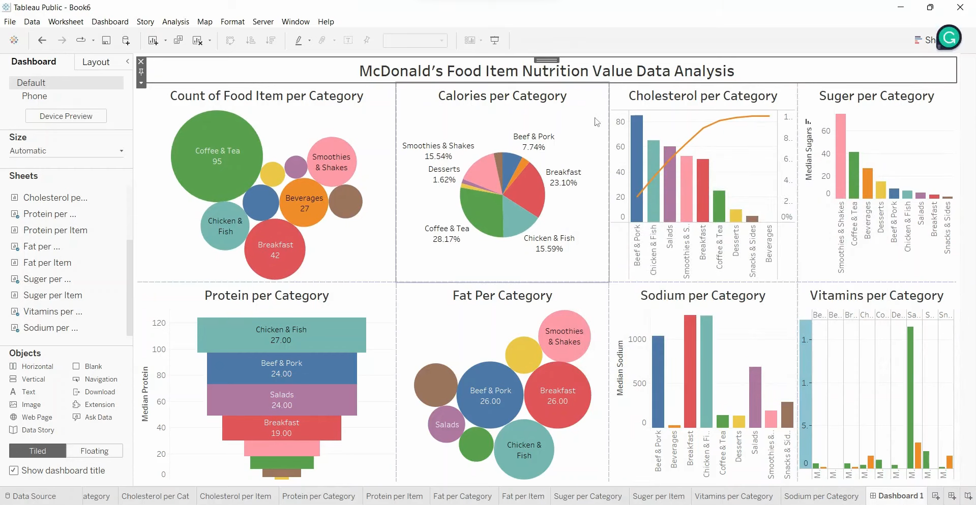
Screenshots

